Slide 1


CAPSTONE PROJECT AI-Based Student Performance Analysis
Presented By
Student Name: Kuldeep Kumar Parmar
College Name: Acropolis Institute of technology and research
Department: CSIT
Email ID: kuldeeparmar205@gmail.com
AICTE Student ID: STU6458582a275cc1683511338

Slide 2
OUTLINE
Problem Statement (Should not include solution)
Proposed System/Solution
System Development Approach (Technology Used)
Algorithm & Deployment
Result (Output Image)
Conclusion
Future Scope
References

Slide 3
Problem Statement
Educational institutions often face challenges in identifying students who may be at risk of low academic performance. Traditional methods rely heavily on exam results and manual observation, which can be time-consuming, inconsistent, and often too late for meaningful intervention.
There is a growing need to understand the patterns and factors that contribute to student performance. However, analyzing large volumes of academic and behavioral data manually is difficult, and key insights often remain hidden. This lack of timely insights can lead to missed opportunities for early support and performance improvement

Slide 4
Proposed Solution
The proposed system is designed to tackle the challenge of identifying and classifying students based on their academic performance levels. By leveraging data analytics and machine learning techniques, the system aims to provide insights that help in timely academic intervention and decision-making.
Data Collection
Utilized a structured dataset containing student academic records and behavioral indicators such as gender, grade level, participation, resource usage, and absenteeism.
The dataset also includes final performance labels categorized as High, Medium, or Low.
Data Preprocessing
Cleaned and transformed the dataset to handle irrelevant columns, missing values, and inconsistent formats.
Applied label encoding to convert categorical variables into numerical form suitable for ML models.
Split the data into training and testing sets to evaluate model performance effectively.
Machine Learning Algorithm
Implemented multiple supervised learning models including Decision Tree, Random Forest, Logistic Regression, Perceptron, and MLP Classifier.
Trained models on student features to classify performance levels and compared their accuracy using evaluation metrics.
Evaluation
Assessed each model's performance using precision, recall, F1-score, and overall accuracy.
Compared results to identify the most reliable model for predicting student outcomes.
Result
The system can accurately predict the performance class of students based on their academic and behavioral data, aiding institutions in proactive support and personalized learning strategies.

Slide 5
System Approach
The system follows a structured and step-by-step approach to analyze student data and predict their performance level using machine learning techniques.
1. Data Understanding
Load the dataset and explore key features such as gender, grade, participation, absences, and final performance class (H/M/L).
Identify relevant factors influencing student outcomes.
2. Data Preprocessing
Drop irrelevant or redundant columns to reduce noise.
Apply label encoding to convert categorical data into numerical format.
Shuffle and split the dataset into training and testing sets (70/30 ratio).
3. Model Implementation
Train five different ML models:
Decision Tree
Random Forest
Logistic Regression
Perceptron
MLP Neural Network
Fit each model using the training data and test them on unseen data.
4. Evaluation and Comparison
Evaluate models using classification reports and accuracy scores.
Compare predictions to determine the most effective model for student classification.
5. User Interaction
Provide an interactive option to manually input student details.
Predict the student’s performance class using all five models and display results.

Slide 6
Algorithm & Deployment
Algorithm Selection
For this project, multiple supervised machine learning classification algorithms were selected to predict the performance level of students (High, Medium, Low). The selected models include:
Decision Tree Classifier
Random Forest Classifier
Logistic Regression
Perceptron
MLP (Multilayer Perceptron) Classifier
Data Input
The following input features were used to train the models:
Raised Hands
Visited Resources
Number of Discussions
Student Absence Days Other contextual features like gender, grade, and section were removed or encoded based on relevance and impact.

Slide 7
Training Process
The dataset was shuffled and split into 70% training data and 30% testing data.
Label encoding was used to convert categorical columns into numerical values.
Each model was trained on the training set to learn the relationship between input features and the student performance class.
Prediction Process
After training, each model predicted performance classes on the test dataset.
Results were evaluated using accuracy, precision, recall, and F1-score to compare effectiveness.
Additionally, the system allows manual input of student data through the console, enabling real-time prediction using all five models.

Slide 8
Result
The machine learning models were evaluated on a testing dataset, and each demonstrated the ability to classify students into performance categories (High, Medium, Low) with reasonable accuracy. Among the five models used, the Random Forest and MLP Classifier achieved the highest accuracy, showing strong consistency in predictions. The Decision Tree model delivered faster results but with slightly lower precision. Overall, the models performed well on the provided features, and the system successfully predicted outcomes even for manually entered student data, demonstrating its effectiveness in analyzing and forecasting student performance based on academic behavior and activity-related inputs.

Slide 9
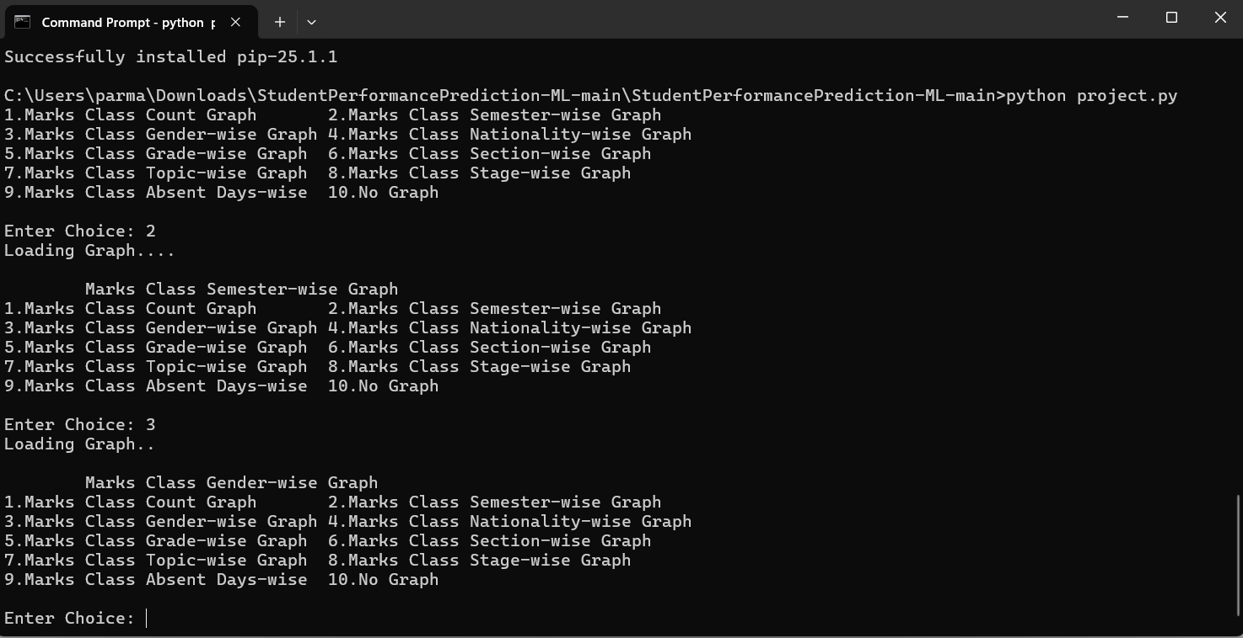
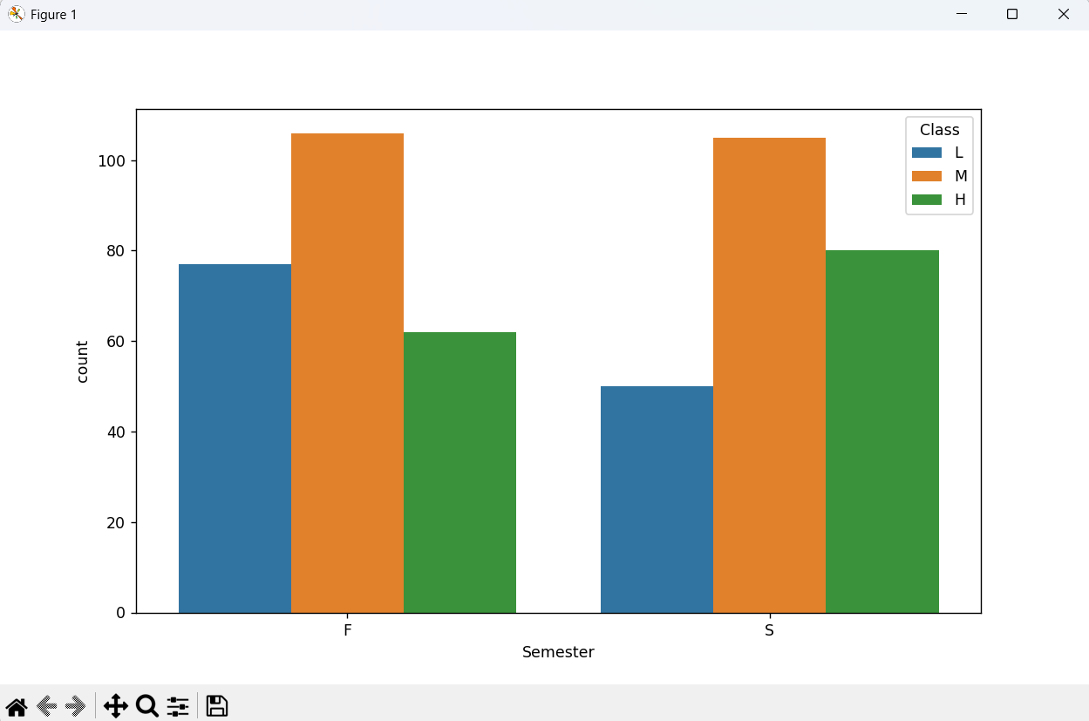

Slide 10
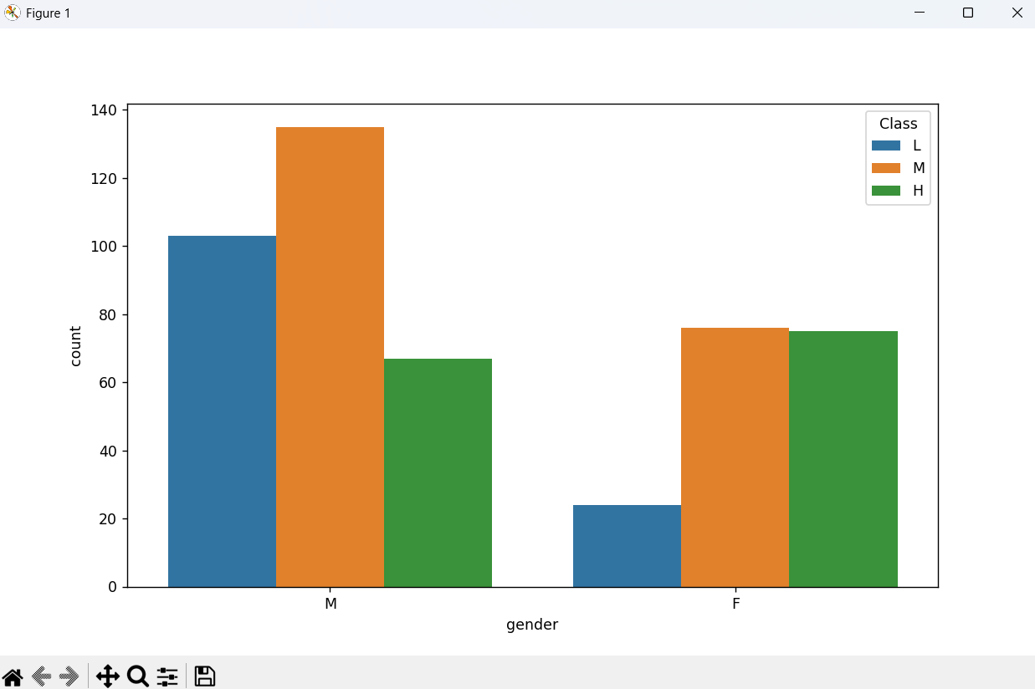
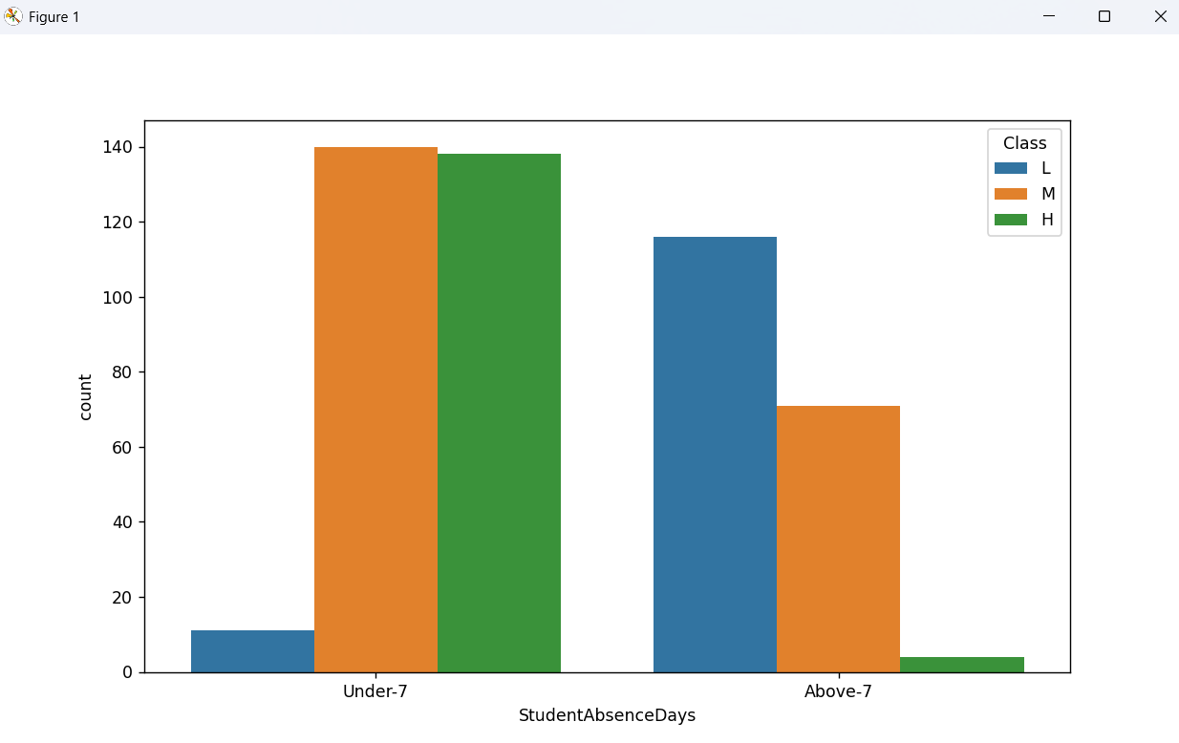

Slide 11
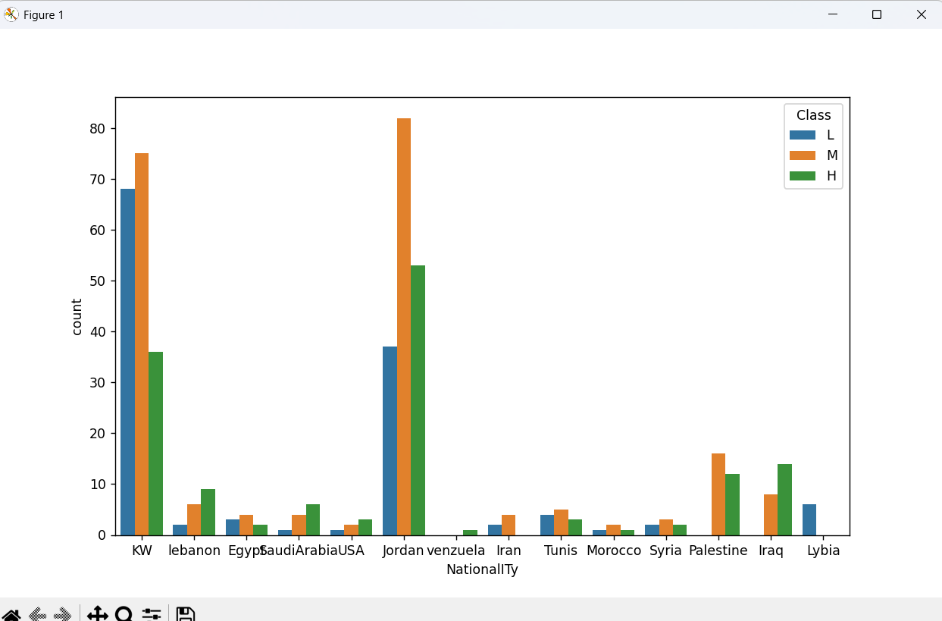

Slide 12
Conclusion
The project successfully demonstrated how machine learning algorithms can be applied to predict student academic performance based on behavioral and academic indicators. The system was able to classify students into performance levels (High, Medium, Low) with good accuracy using models like Random Forest, MLP Classifier, and others. This approach can help educational institutions identify students who may require additional support early on.
During implementation, challenges such as handling categorical data, selecting meaningful features, and ensuring balanced class representation were encountered. Despite these, the system delivered consistent results and provided valuable insights.
With further improvements like automated feature selection, hyperparameter tuning, and integration into an interactive dashboard, the model can be made even more robust and user-friendly for real-world academic environments.

Slide 13
Future scope
There are several opportunities to enhance and expand the current system for improved accuracy, scalability, and real-world usability. Future improvements could include incorporating additional data sources such as real-time attendance tracking, student engagement on learning platforms, and psychological or socio-economic factors to strengthen prediction accuracy.
The machine learning models can be further optimized using techniques like hyperparameter tuning, ensemble stacking, or the adoption of advanced algorithms such as XGBoost or deep learning frameworks.
The system can also be extended to support multiple schools, colleges, or educational regions, allowing broader insights across diverse student populations. Integrating emerging technologies like edge computing, real-time analytics, or AI dashboards could make the system faster, more interactive, and easier to deploy at scale for institutional use.

Slide 14
References
1. Scikit-learn Documentation – Machine Learning in Python https://scikit-learn.org/stable/documentation.html
2. Seaborn Documentation – Statistical Data Visualization https://seaborn.pydata.org
3. UCI Machine Learning Repository – Student Performance Dataset https://archive.ics.uci.edu/ml/datasets/Student+Performance
4.Python Official Documentation https://docs.python.org/3
GitHub Link: https://github.com/Kuldeep-205/ML-Project_Internship

Slide 15
Thank you

